Slide 1
Virtualization and Cloud Computing

Slide 2
Definition
Virtualization is the ability to run multiple operating systems on a single physical system and share the underlying hardware resources*
It is the process by which one computer hosts the appearance of many computers.
Virtualization is used to improve IT throughput and costs by using physical resources as a pool from which virtual resources can be allocated.
*VMWare white paper, Virtualization Overview

Slide 3
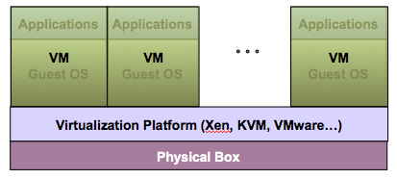
Virtualization Architecture
A Virtual machine (VM) is an isolated runtime environment (guest OS and applications)
Multiple virtual systems (VMs) can run on a single physical system

Slide 4
Hypervisor
A hypervisor, a.k.a. a virtual machine manager/monitor (VMM), or virtualization manager, is a program that allows multiple operating systems to share a single hardware host.
Each guest operating system appears to have the host's processor, memory, and other resources all to itself. However, the hypervisor is actually controlling the host processor and resources, allocating what is needed to each operating system in turn and making sure that the guest operating systems (called virtual machines) cannot disrupt each other.

Slide 5
Benefits of Virtualization
Sharing of resources helps cost reduction
Isolation: Virtual machines are isolated from each other as if they are physically separated
Encapsulation: Virtual machines encapsulate a complete computing environment
Hardware Independence: Virtual machines run independently of underlying hardware
Portability: Virtual machines can be migrated between different hosts.

Slide 6
Virtualization in Cloud Computing
Cloud computing takes virtualization one step further:
You don’t need to own the hardware
Resources are rented as needed from a cloud
Various providers allow creating virtual servers:
  Choose the OS and software each instance will have
  The chosen OS will run on a large server farm
  Can instantiate more virtual servers or shut down existing ones within minutes
You get billed only for what you used

Slide 7
Virtualization Security Challenges
The trusted computing base (TCB) of a virtual machine is too large.
TCB: A small amount of software and hardware that security depends on and that we distinguish from a much larger amount that can misbehave without affecting security*
Smaller TCB → more security
*Lampson et al., “Authentication in distributed systems: Theory and practice,” ACM TCS 1992

Slide 8
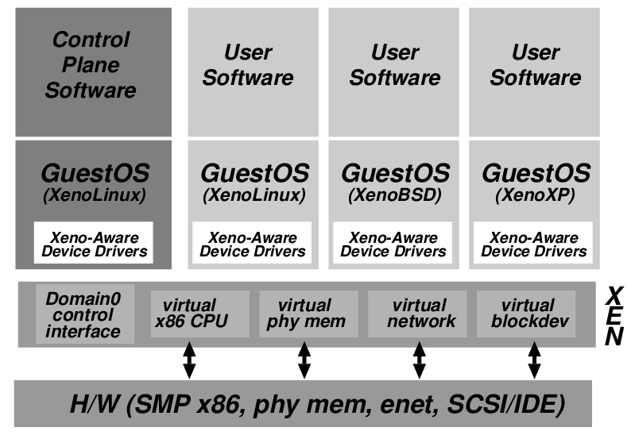
Xen Virtualization Architecture and the Threat Model
Management VM – Dom0
Guest VM – Dom
Dom0 may be malicious
  Vulnerabilities
  Device drivers
  Careless/malicious
  administration
Dom0 is in the TCB of DomU because it can access the memory of DomU, which may cause information leakage/modification

Slide 9
Virtualization Security Requirements
Scenario: A client uses the service of a cloud computing company to build a remote VM
  A secure network interface
  A secure secondary storage
  A secure run-time environment
    Build, save, restore, destroy

Slide 10
Virtualization Security Requirements
A secure run-time environment is the most fundamental
  The first two problems already have solutions:
    Network interface: Transport layer security (TLS)
    Secondary storage: Network file system (NFS)
  The security mechanism in the first two rely on a secure run-time environment
    All the cryptographic algorithms and security protocols reside in the run-time environment

Slide 11
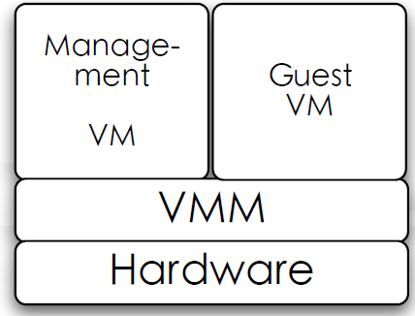
Smaller TCB Solution
Smaller TCB
Actual TCB
*Secure Virtual Machine Execution under an Untrusted Management OS. C. Li, A. Raghunathan, N.K. Jha. IEEE CLOUD, 2010.

Slide 12
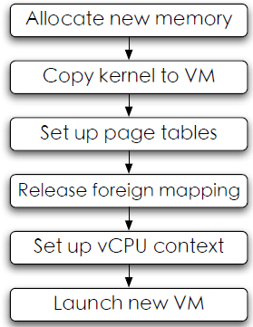
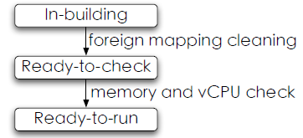
Domain building
Building process

Slide 13
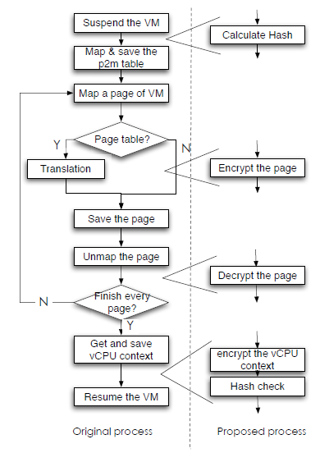
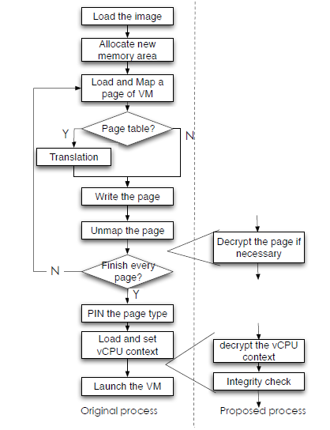
Domain save/restore

Slide 14

Hypervisor Vulnerabilities
Malicious software can run on the same server:
  Attack hypervisor
  Access/Obstruct other VMs
Guest VM1
Guest VM2
Apps
Apps
OS
OS
Hypervisor
servers
Physical Hardware

Slide 15
NoHype*
NoHype removes the hypervisor
  There’s nothing to attack
  Complete systems solution
  Still retains the needs of a virtualized cloud infrastructure
Guest VM1
Guest VM2
Apps
Apps
OS
OS
No hypervisor
Physical Hardware
*NoHype: Virtualized Cloud Infrastructure without the Virtualization. E. Keller, J. Szefer, J. Rexford, R. Lee. ISCA 2010.

Slide 16
Roles of the Hypervisor
Isolating/Emulating resources
  CPU: Scheduling virtual machines
  Memory: Managing memory
  I/O: Emulating I/O devices
Networking
Managing virtual machines
Push to HW /
Pre-allocation
Remove
Push to side

Slide 17
Removing the Hypervisor
Scheduling virtual machines
  One VM per core
Managing memory
  Pre-allocate memory with processor support
Emulating I/O devices
  Direct access to virtualized devices
Networking
  Utilize hardware Ethernet switches
Managing virtual machines
  Decouple the management from operation

Slide 18
References
http://www.vmware.com/pdf/virtualization.pdf
NoHype: Virtualized Cloud Infrastructure without the Virtualization. E. Keller, J. Szefer, J. Rexford, R. Lee. ISCA 2010.
Secure Virtual Machine Execution under an Untrusted Management OS. C. Li, A. Raghunathan, N.K. Jha. IEEE CLOUD, 2010.
An Introduction to Virtualization and Cloud Technologies to Support Grid Computing. I.M. Lorente. EGEE08.

